Slide 1
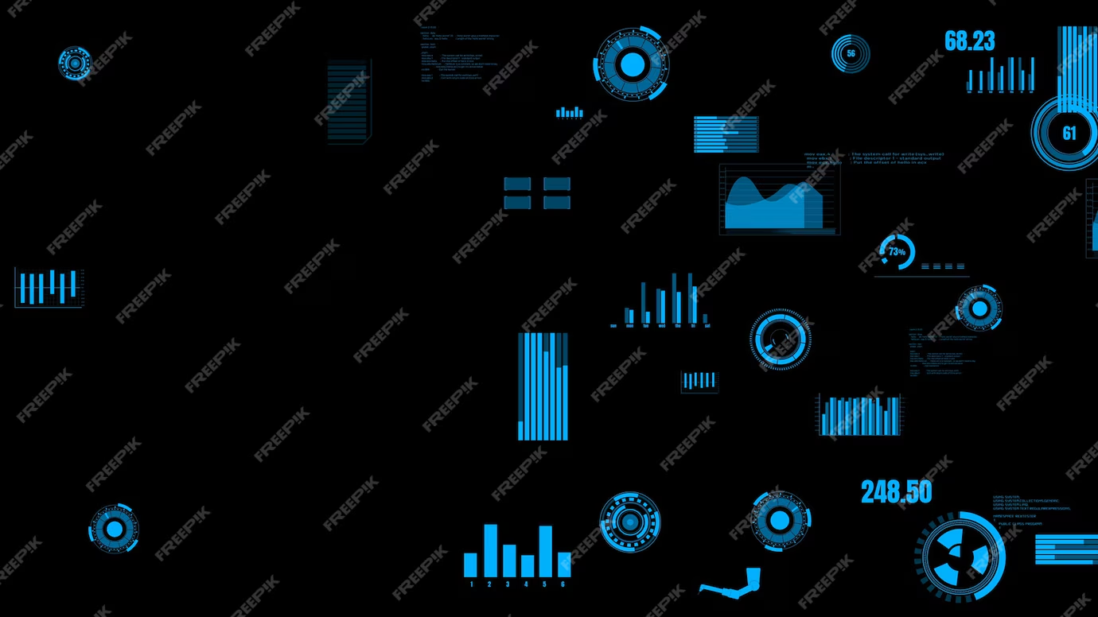


Microsoft | powerbi
Capstone Project - Retail Analysis

Slide 2

Retail Analysis
Retail analysis is the process of providing analytical data on inventory levels, supply chain movement, consumer demand, sales, etc. that are crucial for making marketing, and procurement decisions. The analytics on demand and supply data can be used for maintaining procurement levels and also for making marketing decisions. Retail analytics gives us detailed customer insights along with insights into the business and processes of the organisation with scope and need for improvement
sales analysis is a structured review of your company’s sales data. A thorough analysis can reveal what’s working and what isn’t, and bring opportunities for improvement into clearer focus. For example, it can tell you which sales channels are delivering the most ROI, what factors are impacting conversion rates, and can help you determine your customer acquisition costs.
Customer analysis is collecting and analyzing customer information to gain insights into their needs, preferences, behaviours, and characteristics. Customer analysis typically involves collecting data from various sources, such as surveys, interviews, focus groups, sales data, and social media analytics. This data is used to identify patterns and trends in customer behaviour, such as purchasing habits, product usage, and brand loyalty
Market analysis is a comprehensive study of a specific market within an industry, including an examination of its various components, such as market size, key success factors, distribution channels, target audience, profitability and growth rate, and market trends
Product analysis is the process of gathering, defining, and analyzing data about a product or service to make better decisions. Product analysis involves examining product features, costs, availability, quality, appearance and other aspects. Product analysis is conducted by potential buyers, by product managers by attempting to understand competitors and by third-party reviewers.
Financial analysis is the process of evaluating businesses, projects, budgets, and other finance-related transactions to determine their performance and suitability. Typically, financial analysis is used to analyze whether an entity is stable, solvent, liquid, or profitable enough to warrant a monetary investment
Sales Analysis
Customer Analysis
Market Analysis
Product Analysis
Financial Analysis

Slide 3




Objective: The objective of this project is to create a comprehensive Power BI dashboard utilizing the sample Retail Database. The dashboard aims to provide valuable insight into evaluating sales trends over time and by region, and period to identify trends and high-performing areas. Assess stock levels, turnover rates, and demand patterns to optimize inventory management, identify top-performing employees and understand factors contributing to their success.
Scope: The scope of this project involves a comprehensive analysis of the retail dataset to gain valuable insights into the company's operations. This analysis will cover various aspects, including the company's offices, employees, customers, products, product lines, orders, order details, and payments.
Goal: The goal is to leverage this data to improve business decision-making, identify trends, and enhance operational efficiency. Analyze customer data to identify purchasing patterns, customer segmentation, and customer lifetime value. Evaluate product and order data to optimize stock levels, identify high-demand products, and manage product lines effectively. Use data to refine marketing strategies, identify high-performing sales representatives, and optimize sales processes and enhance overall efficiency.

Slide 4



Insights and Recommendations: The Power BI dashboard will generate valuable insights into identifying top customers by sales volume and frequency of purchases and identify best-selling products and product lines. It will evaluate sales trends over time and by region. Identify peak sales periods and plan promotions accordingly.
Reports and Presentations: The final deliverable will consist of a detailed report describing the data sources, data modelling methodologies and data cleansing processes used in creating the Power BI dashboard. The report will include a step-by-step guide on how to interpret the insights and use the dashboard for decision-making. The presentation will show a High-level overview of key findings, insights, and recommendations, detailed recommendations for each area of analysis and focus on actionable insights and strategic recommendations.
The Power BI dashboard, along with the report and presentation, will serve as a powerful business analytic tool that can significantly aid in achieving the objectives outlined for this retail project, remove duplicates, handle missing values, and reshape the data as needed for analysis and Create interactive dashboards and reports to provide an overview of key metrics and performance indicators, making it easy to spot trends and outliers.

Slide 5
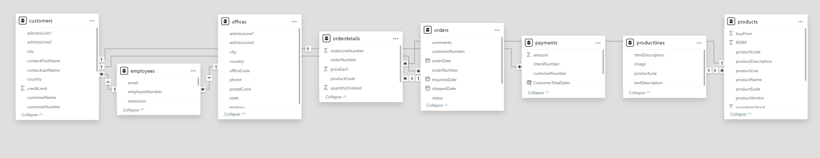
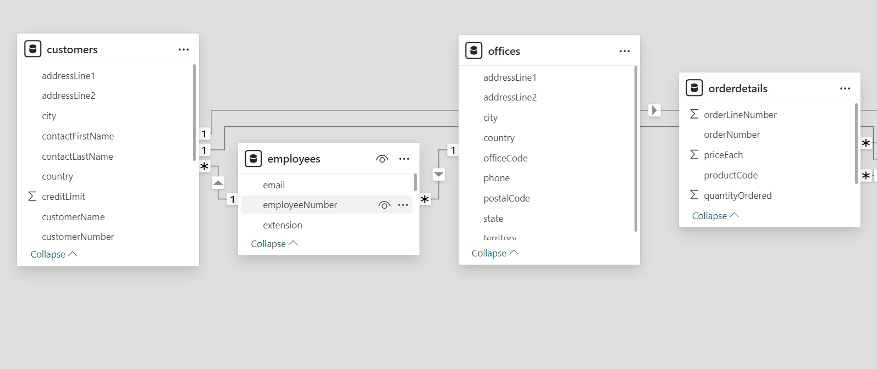
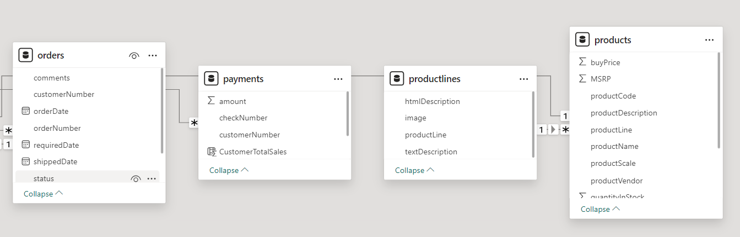

Slide 6

Power Bi
Problem
Statements

Slide 7
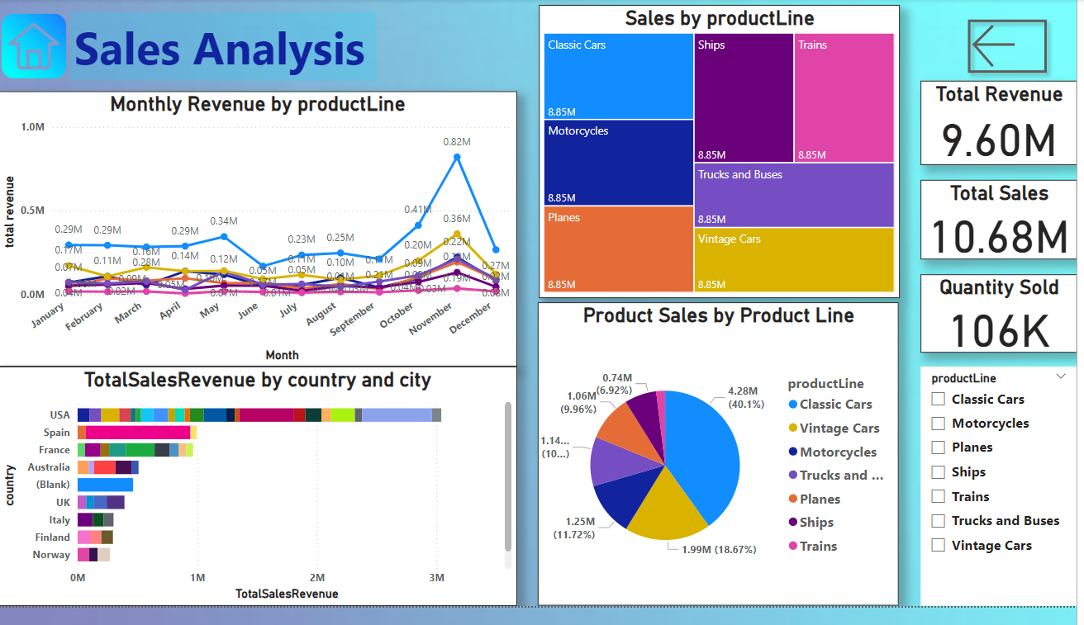

Slide 8

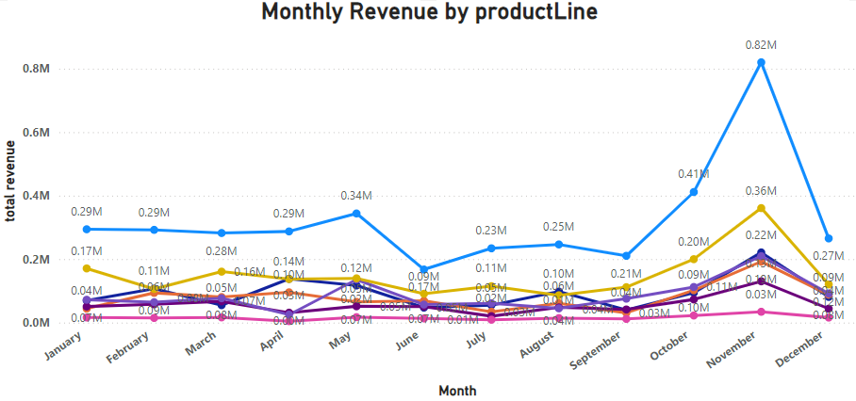
How does monthly revenue vary across different product categories?
From the Sales Report, Calculate the average monthly revenue for each product category. Identify any trends or patterns in the data. For example, we might notice that certain categories have higher revenue in certain months (seasonal trends). Calculate the total revenue for each product category across all months.

Slide 9
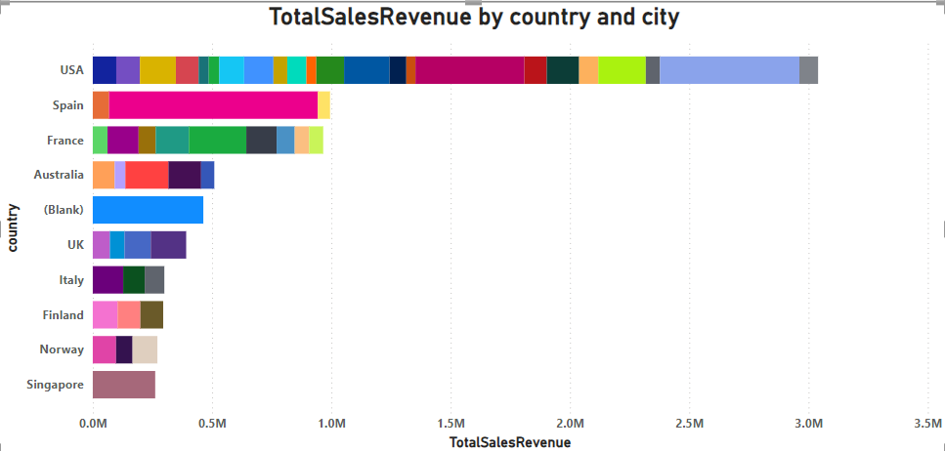
How does monthly revenue vary across different product categories?
From the Sales Report, Calculate the average monthly revenue for each product category. Identify any trends or patterns in the data. For example, we might notice that certain categories have higher revenue in certain months (seasonal trends). Calculate the total revenue for each product category across all months. Conversely countries like USA, Spain exhibits the highest sales.

Slide 10
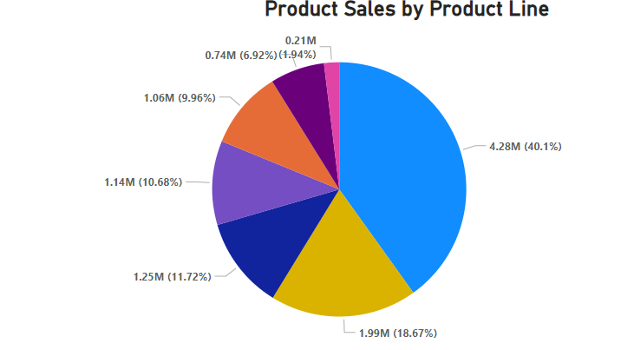
How does monthly revenue vary across different product categories?
From the Sales Report, Calculate the average monthly revenue for each product category. Identify any trends or patterns in the data. For example, we might notice that certain categories have higher revenue in certain months (seasonal trends). Calculate the total revenue for each product category across all months.

Slide 11
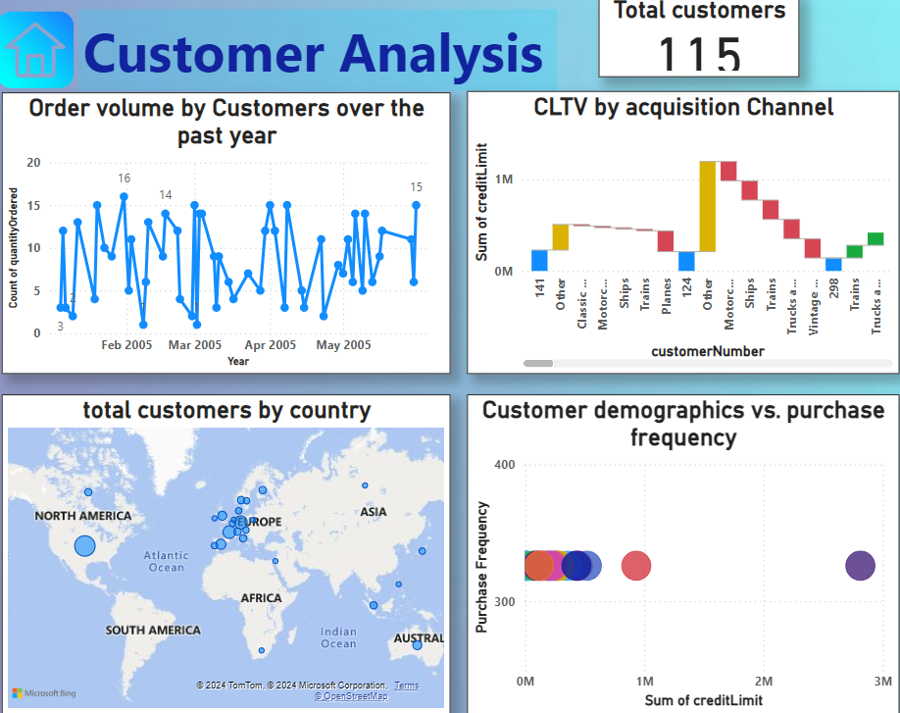

Slide 12
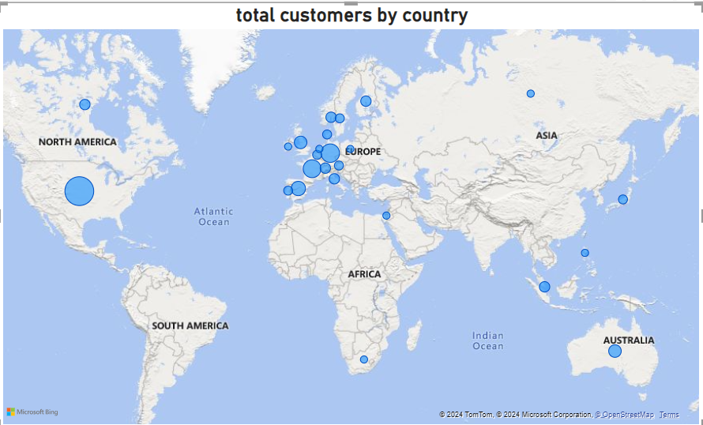
What is the distribution of customers across different demographic segments? (Visual: Customer segmentation by demographics)
From the Sales Report, Calculate the average monthly revenue for each product category. Identify any trends or patterns in the data. For example, we might notice that certain categories have higher revenue in certain months (seasonal trends). Calculate the total revenue for each product category across all months.

Slide 13
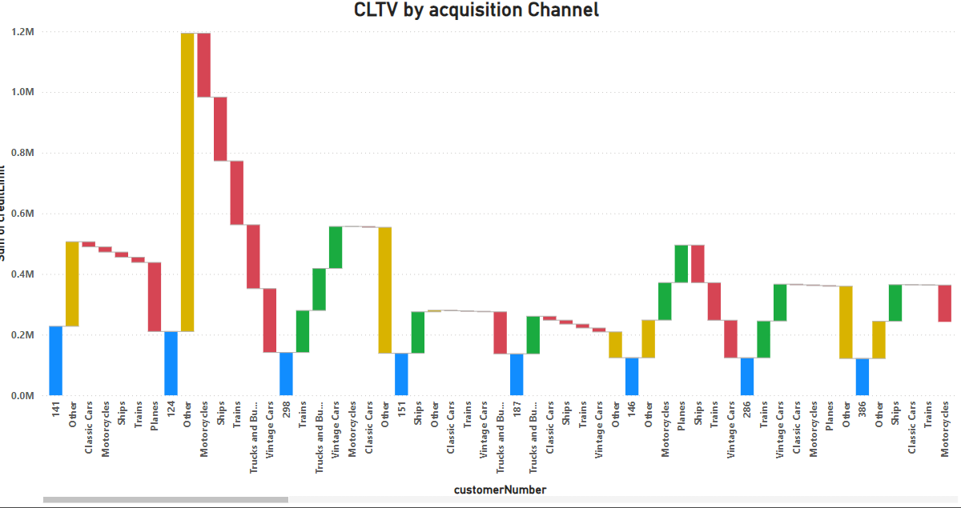
How does customer lifetime value vary for different customer acquisition channels? (Visual: CLTV by acquisition channel)
From the Sales Report, Calculate the average monthly revenue for each product category. Identify any trends or patterns in the data. For example, we might notice that certain categories have higher revenue in certain months (seasonal trends). Calculate the total revenue for each product category across all months.

Slide 14
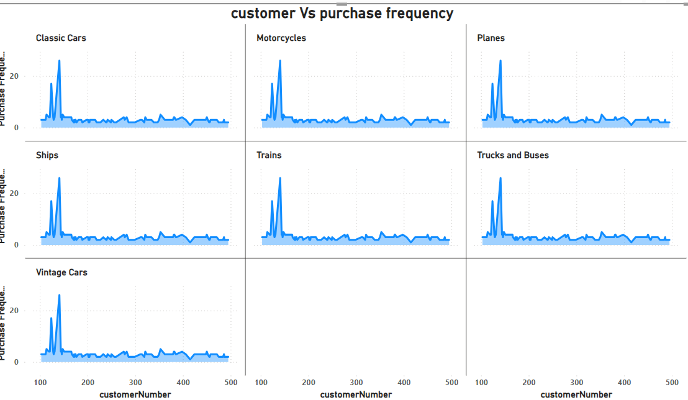
How does customer lifetime value vary for different customer acquisition channels?
From the Sales Report, Calculate the average monthly revenue for each product category. Identify any trends or patterns in the data. For example, we might notice that certain categories have higher revenue in certain months (seasonal trends). Calculate the total revenue for each product category across all months.

Slide 15
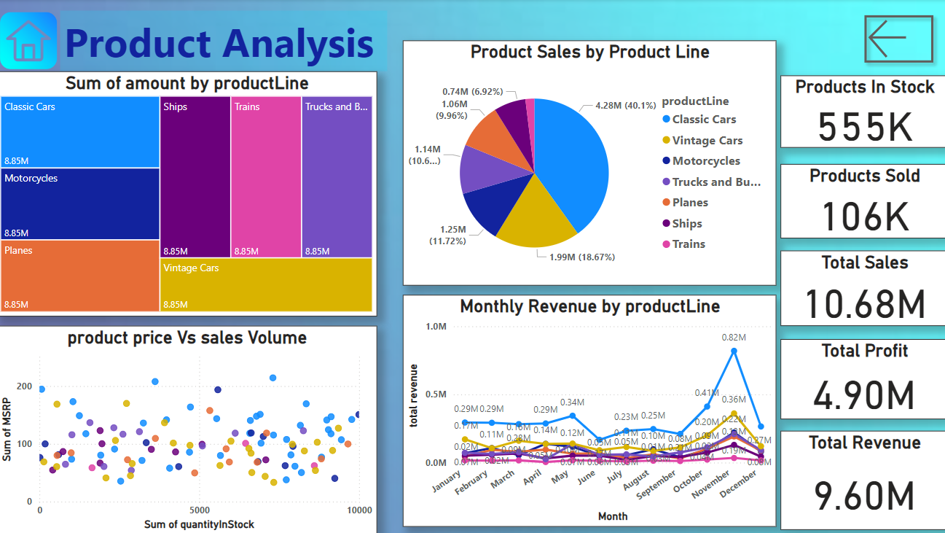

Slide 16
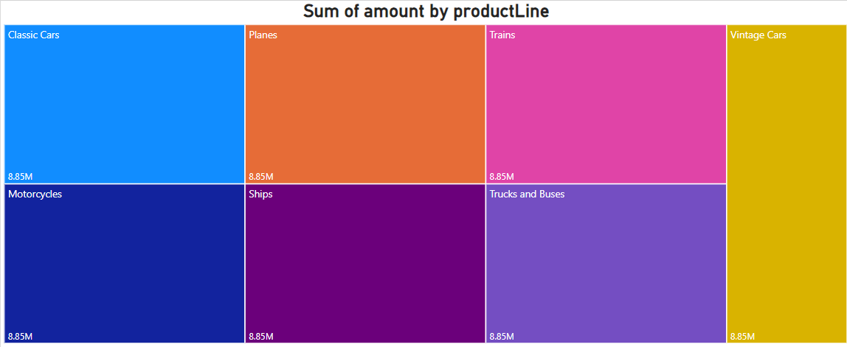
Retail Analysis :
How does the sales performance of top customers compare to the rest?
From the Sales Report, Calculate the average monthly revenue for each product category. Identify any trends or patterns in the data. For example, we might notice that certain categories have higher revenue in certain months (seasonal trends). Calculate the total revenue for each product category across all months.

Slide 17
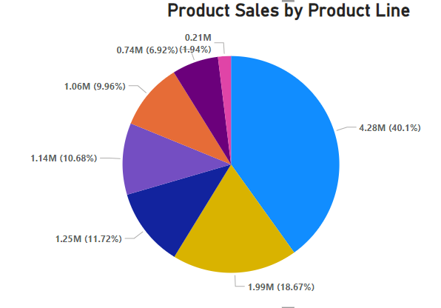
Retail Analysis :
How does the sales performance of top customers compare to the rest?
Gleaning from customer reports, Power BI visualises how your customers are spread across different demographic groups such as Age Groups (e.g., 18-24, 25-34, etc.) or Income Levels (Low, Medium, High). Distribution of sales by customers across the countries

Slide 18
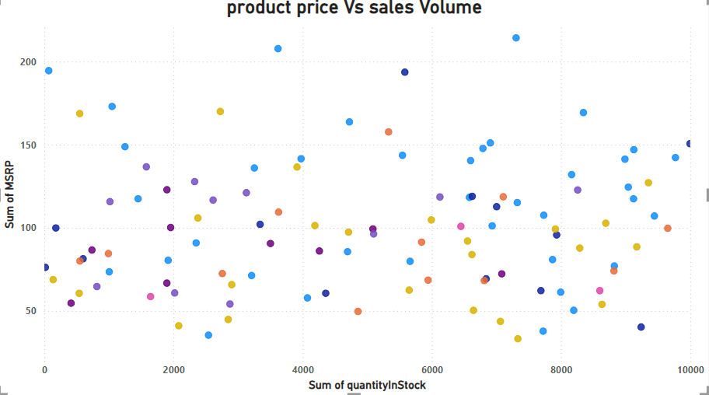
Retail Analysis :
How does the sales performance of top customers compare to the rest?
From the Sales Report, Calculate the average monthly revenue for each product category. Identify any trends or patterns in the data. For example, we might notice that certain categories have higher revenue in certain months (seasonal trends). Calculate the total revenue for each product category across all months.

Slide 19
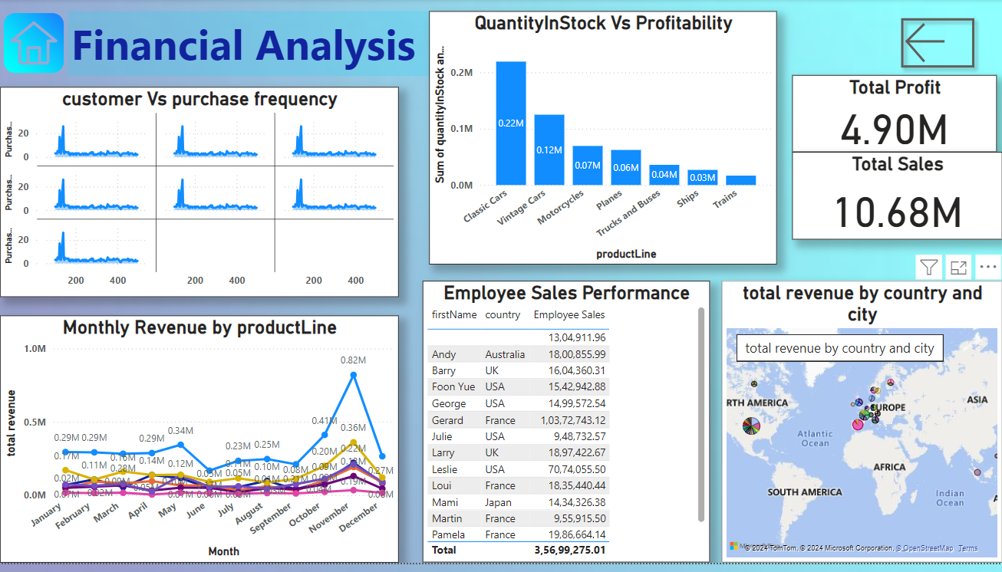
Retail Analysis :

Slide 20
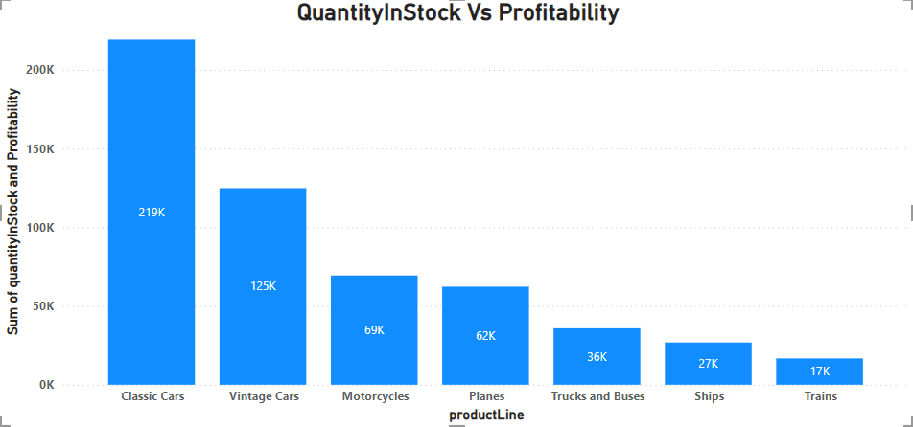
Retail Analysis :
How does the profitability of different products compare based on their quantity in stock?
From the Sales Report, Calculate the average monthly revenue for each product category. Identify any trends or patterns in the data. For example, we might notice that certain categories have higher revenue in certain months (seasonal trends). Calculate the total revenue for each product category across all months.

Slide 21
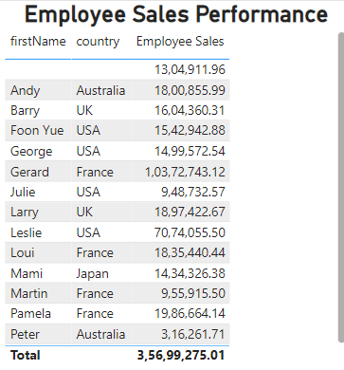
Retail Analysis :
How does the profitability of different products compare based on their quantity in stock?
From the Sales Report, Calculate the average monthly revenue for each product category. Identify any trends or patterns in the data. For example, we might notice that certain categories have higher revenue in certain months (seasonal trends). Calculate the total revenue for each product category across all months.

Slide 22
Retail Analysis :
How does the profitability of different products compare based on their quantity in stock?
From the Sales Report, Calculate the average monthly revenue for each product category. Identify any trends or patterns in the data. For example, we might notice that certain categories have higher revenue in certain months (seasonal trends). Calculate the total revenue for each product category across all months.

Slide 23
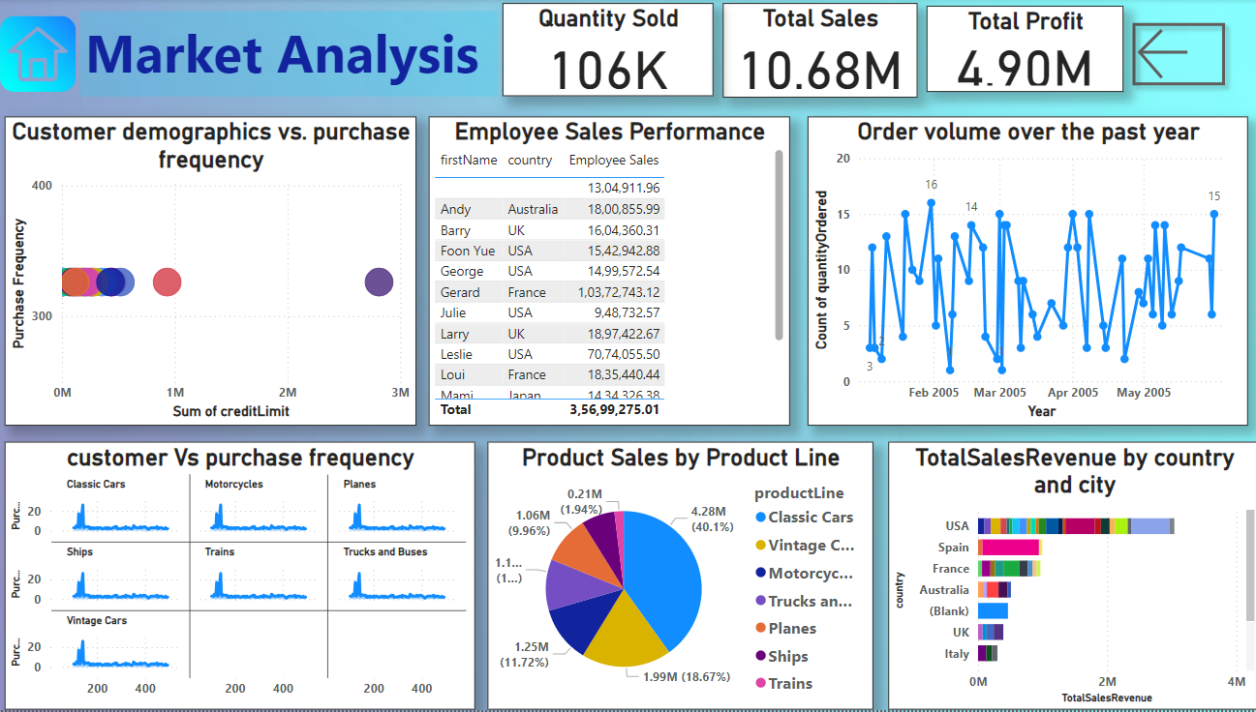
Retail Analysis :

Slide 24
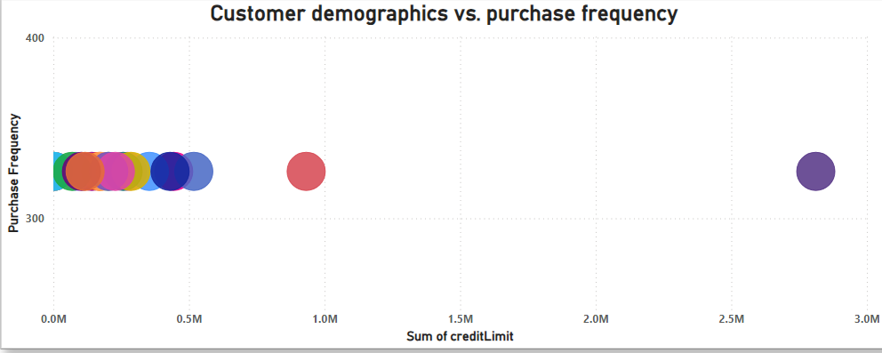
Retail Analysis :
What is the correlation between customer demographics and purchase frequency?
From the Sales Report, Calculate the average monthly revenue for each product category. Identify any trends or patterns in the data. For example, we might notice that certain categories have higher revenue in certain months (seasonal trends). Calculate the total revenue for each product category across all months.

Slide 25
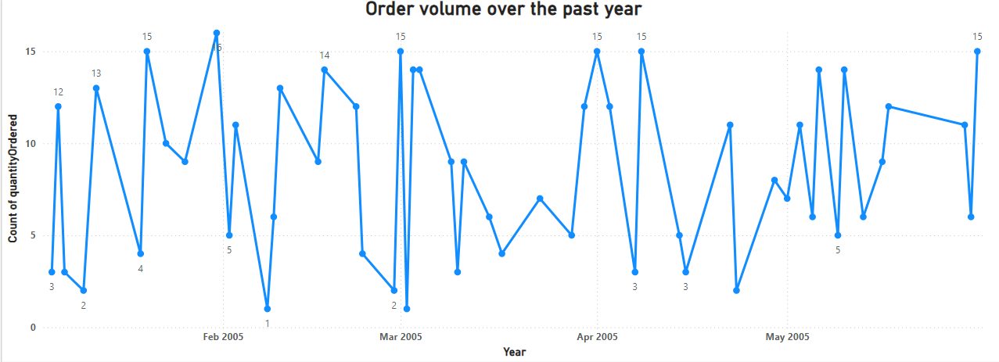
Retail Analysis :
What is the correlation between customer demographics and purchase frequency?
From the Sales Report, Calculate the average monthly revenue for each product category. Identify any trends or patterns in the data. For example, we might notice that certain categories have higher revenue in certain months (seasonal trends). Calculate the total revenue for each product category across all months.

Slide 26
What is the correlation between customer demographics and purchase frequency?
From the Sales Report, Calculate the average monthly revenue for each product category. Identify any trends or patterns in the data. For example, we might notice that certain categories have higher revenue in certain months (seasonal trends). Calculate the total revenue for each product category across all months.

Slide 27

EDA Problem Statements

Slide 28
How do customer preferences and behavior differ based on demographic factors, and how can they be leveraged for personalized marketing campaigns?
Customer preferences and behavior are influenced by a variety of demographic factors, creating a rich tapestry of needs and desires. Here's how demographics can shape customer behavior and how to leverage that knowledge for personalized marketing campaigns.
Younger generations tend to be more tech-savvy and open to new trends, while older generations might prioritize established brands and traditional marketing channels.
Customers with higher disposable income might be willing to splurge on premium products or experiences, while budget-conscious consumers seek value and affordability.
Geographic location influences preferences for products and services. People in warm climates might prioritize breathable clothing, while those in colder regions might favor winter gear. Cultural norms also play a role, shaping what resonates with customers.

Slide 29
We don’t have direct data available to correlate customer Lifetime value vary for different customer acquisition channels?
Customer lifetime value (CLTV) can vary significantly for different customer acquisition channels. Some channels, like paid advertising, involve higher acquisition costs. This can initially lower CLTV if customers acquired through that channel don't spend enough to offset those costs.
Marketing automation and analytics platforms can provide detailed insights into customer acquisition sources and their impact on CLTV.
Many Customer Relationship Management (CRM) systems allow you to track customer acquisition channels and calculate CLTV metrics.
By analyzing CLTV by acquisition channels, valuable insights into the effectiveness of your customer acquisition strategies. Focusing on channels that generate high-value customers allows you to optimize marketing spend, improve customer acquisition efforts, and ultimately drive long-term business growth.

